Slide 1


Foodie : Your Organic Food Marketplace
Under The Guidance Of
INTERNAL GUIDE
Prof. Sohil Parmar
Developed By: ---
Soumya Das (2405103470003)
Mayank Patidar (2405103470005)
Shivam Kumar (2405103450001)
Submitted To:
Parul Institute Of Computer Application
Faculty of IT & Computer Science,
PARUL University

Slide 2
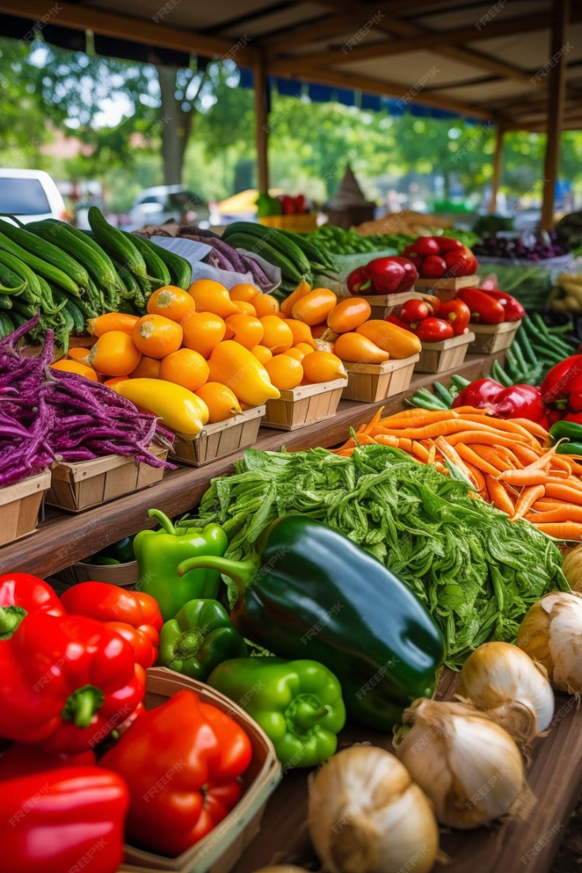
Foodie : Your Organic Food Marketplace
Welcome to Foodie, your one-stop shop for the freshest, most sustainable organic produce. We're passionate about connecting you with the best quality food, grown with care and delivered straight to your door.
Fresh, organic produce and natural foods.
High-quality, sustainably sourced ingredients.
Delivered straight to your doorstep.
Healthy eating and supporting local farmers.

Slide 3

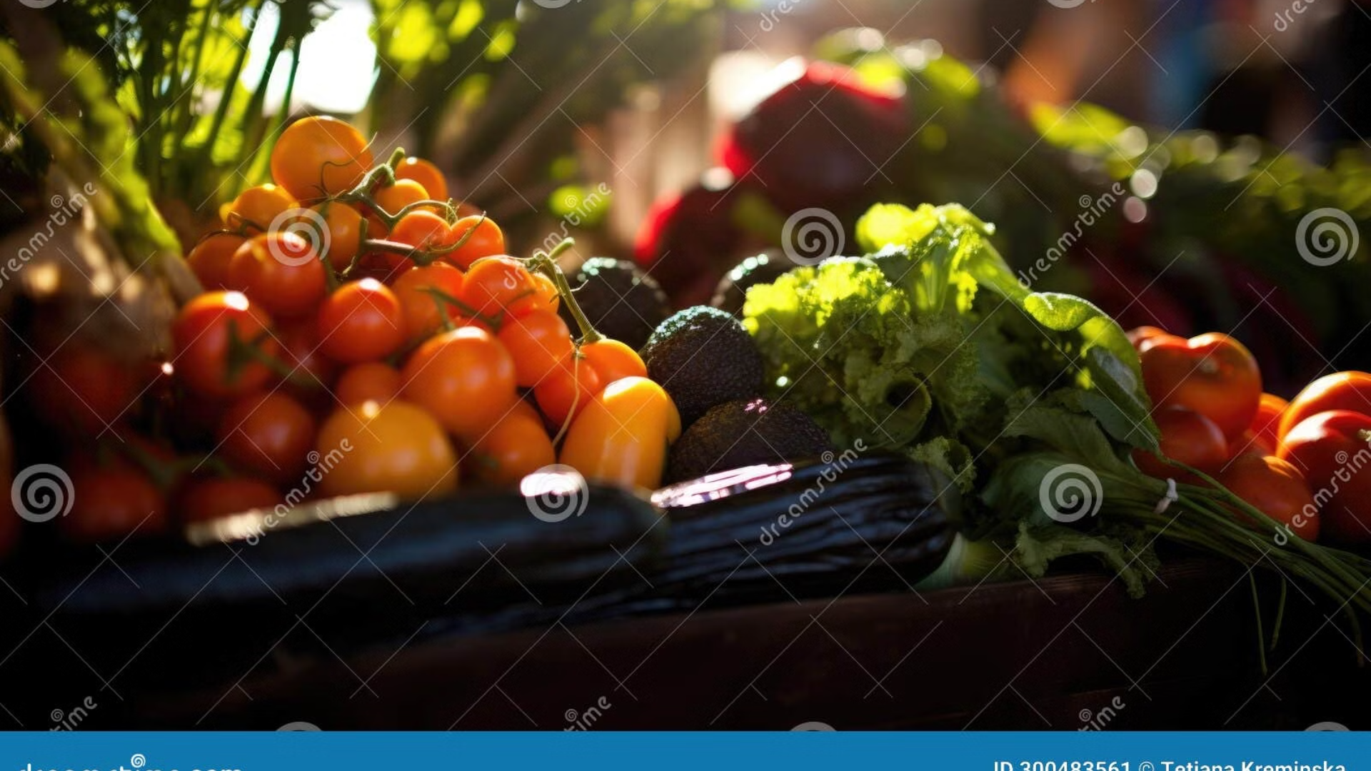
Connecting Food Lovers with Organic Goodness
Our Mission: Bringing Fresh, Sustainable Produce to Your Doorstep
About Foodie
Our Mission
Commitment to Quality
Foodie is an online marketplace that connects consumers with local farmers and organic food producers. We offer a wide selection of fresh fruits, vegetables, and other natural products, all carefully sourced and delivered directly to your door.
Our mission is to make healthy eating accessible to everyone. We believe in supporting sustainable farming practices and promoting the benefits of organic food. We strive to create a platform where consumers can trust the quality and origin of their food.
Our commitment to sustainability extends beyond organic practices. We source our produce from local farms committed to organic practices, ensuring the highest quality and freshest ingredients.

Slide 4

Who We Serve
Health-Conscious Individuals
Families
We understand the importance of providing healthy food for families. We offer a variety of options to meet diverse dietary needs, ensuring everyone enjoys their meals.
For those seeking nutritious and delicious food options, we offer a curated selection of organic produce and natural products. We prioritize your health and well-being.
Sustainable Living Advocates
We support individuals who value sustainable practices. By choosing Foodie, you contribute to a more sustainable food system, supporting local farmers and reducing your environmental footprint.

Slide 5
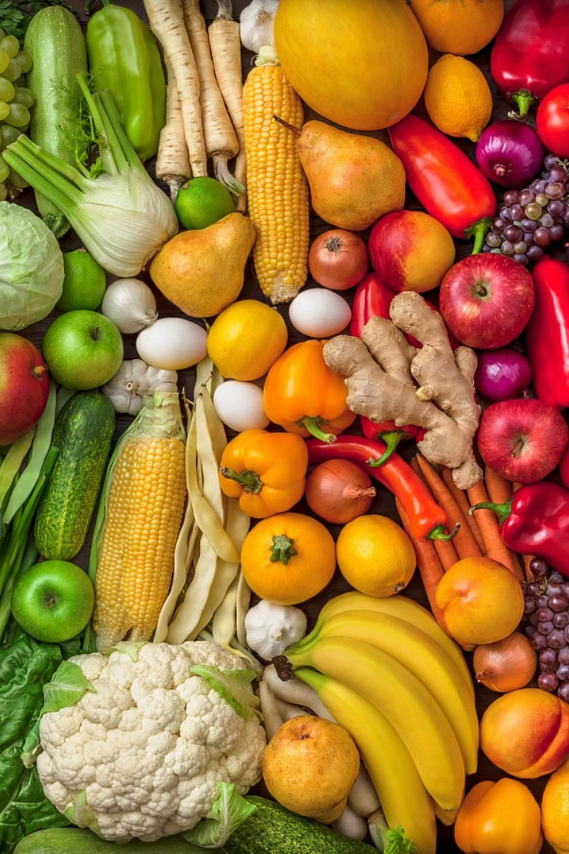





Product Categories
Fresh Vegetables
Fresh Fruits
From leafy greens to root vegetables, we offer a wide range of fresh, organic vegetables, harvested at their peak.
Discover a delightful selection of organic fruits, from juicy berries to seasonal favorites, bursting with flavor and nutrients.
Grains & Legumes
Dairy & Eggs
Enjoy a variety of organic grains and legumes, including quinoa, lentils, and rice, perfect for healthy and delicious meals.
Indulge in organic dairy products and fresh eggs, sourced from local farms committed to ethical and sustainable practices.

Slide 6

Foodie: Your Online Marketplace
1
User-Friendly Interface
2
Secure Payment Options
Our intuitive website design makes it easy to browse, search, and find exactly what you need.
We prioritize your security with a range of trusted payment methods, ensuring safe and convenient transactions.
3
Product Filtering
4
Customer Reviews
Easily narrow down your search with advanced filtering options, including dietary preferences, product types, and origins.
Read reviews from other customers to make informed decisions about your purchases, helping you discover the best products.

Slide 7
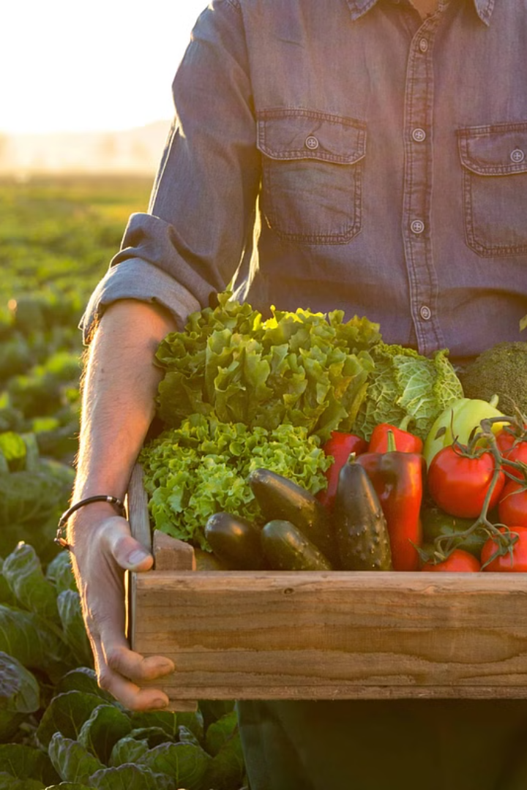



From Farm to Table: Showcasing Our Sustainable Sourcing
Farm Partners
Direct Delivery
Environmentally Conscious
We proudly partner with local farms that share our commitment to organic practices and ethical sourcing.
We minimize transportation distances and carbon footprint by working directly with local farmers.
We prioritize sustainable packaging and minimize waste, contributing to a healthier planet.

Slide 8




Beyond the Marketplace: Connecting You to the Source
Farming Blogs
Explore our insightful blog section, where we share valuable information about organic farming practices, seasonal produce, and recipes.
Local Farming Initiatives
We believe in supporting local farmers and communities. Discover local farmers' markets and Community Supported Agriculture (CSA) programs in your area.
Subscription Services
Enjoy the convenience of regular deliveries with our subscription service. Choose a frequency that suits your needs and get fresh, organic produce delivered straight to your door.

Slide 9

Foodie Blogs: Connecting Customers to the Heart of Farming
1
Farming Practices
2
Seasonal Produce
Learn about the techniques and challenges of organic farming, from seed to harvest.
Discover the best seasonal fruits and vegetables and how to cook with them.
3
Farm Profiles
Get to know the dedicated farmers who provide the delicious produce you enjoy.

Slide 10
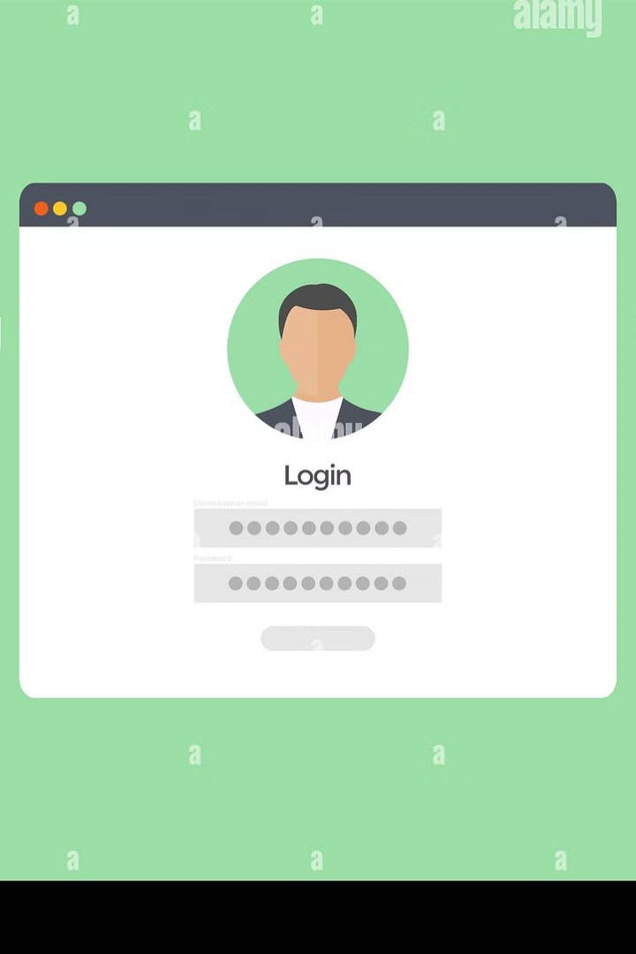
User Account Security & Authentication
Email Authentication
Securely access your account using your registered email address, ensuring the safety of your personal information.
Social Media Login
For convenience, log in using your preferred social media accounts, streamlining the registration process.
Biometric Authentication
Enhance your account security with biometric authentication options like fingerprint or facial recognition, providing an extra layer of protection.

Slide 11
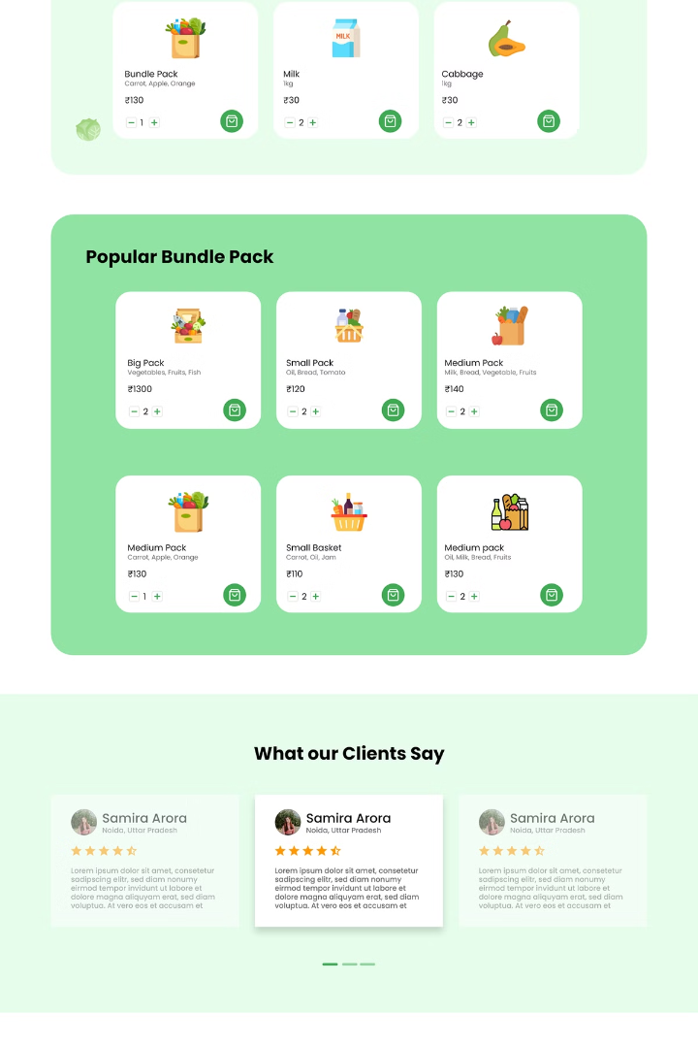
Enhanced Shopping Experience: Intuitive Navigation and Easy Checkout
Browse Our Products
Easily navigate through our diverse product categories and search for your favorites.
Add to Cart
Select your desired items and add them to your cart with just a few clicks.
Secure Checkout
Enjoy a seamless checkout experience with secure payment options and convenient delivery choices.

Slide 12
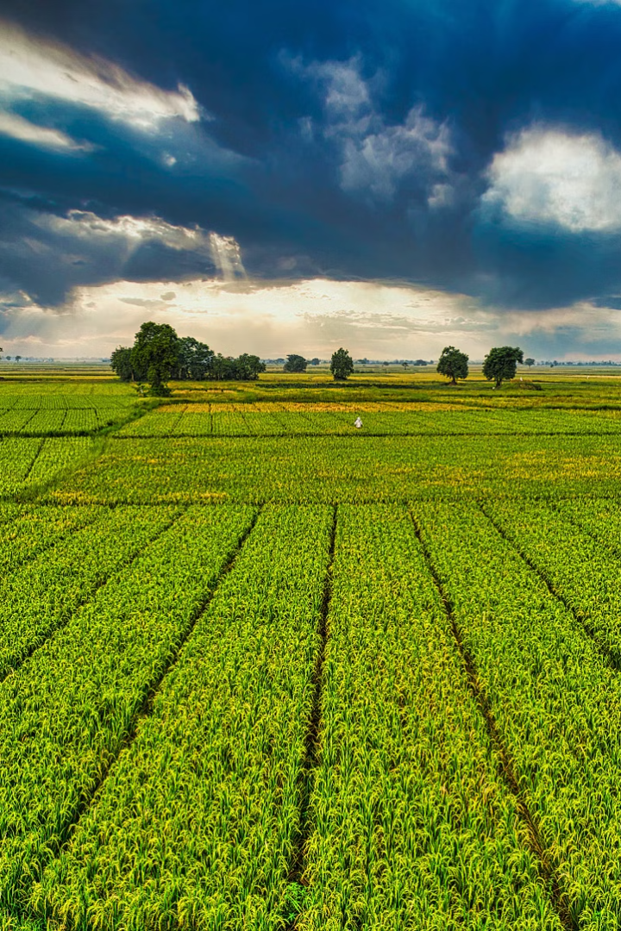
Strengths of the Proposed Structure
1
Comprehensive Coverage
Includes all requested elements: organic produce, farming blogs, location services, product categories, and agricultural programs.
2
Key Features Highlighted
User-friendly interface, secure payments, and customer reviews ensure a robust e-commerce experience.
3
Audience Alignment
Targets health-conscious consumers, families, and sustainability advocates, matching the intended user base.
4
Technology Stack
Appropriate tools (e.g., Shopify, WordPress) ensure scalability and functionality.

Slide 13
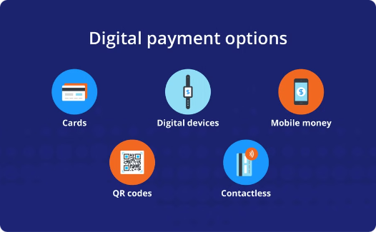
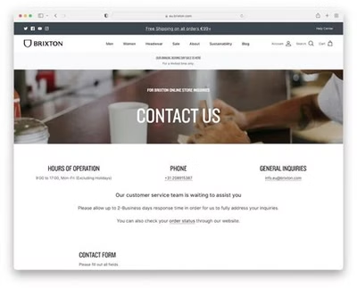
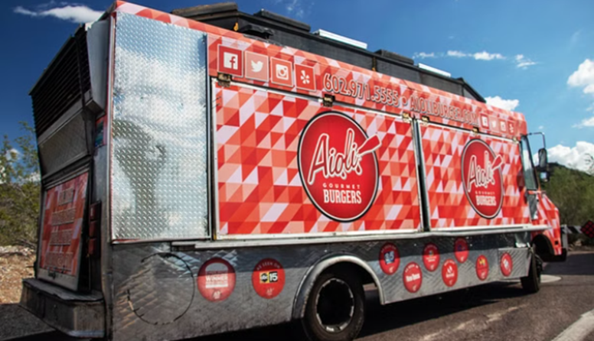
Payment Methods: Secure & Convenient
Secure Payment Options
24/7 Customer Support
Fast and Reliable Delivery
Secure & easy checkout.
Enjoy secure payment options and a transparent return and refund policy
Enjoy quick and reliable delivery straight to your doorstep, with options for same-day or scheduled delivery.

Slide 14



Foodie Rewards: Incentivizing Loyalty and Repeat Business
Exclusive Deals
Enjoy access to special promotions and early access to new products.
Personalized Recommendations
Earn Points
Accumulate points for every purchase, which can be redeemed for discounts and exclusive offers.
Receive tailored recommendations based on your past purchases and preferences.
2
1
3

Slide 15
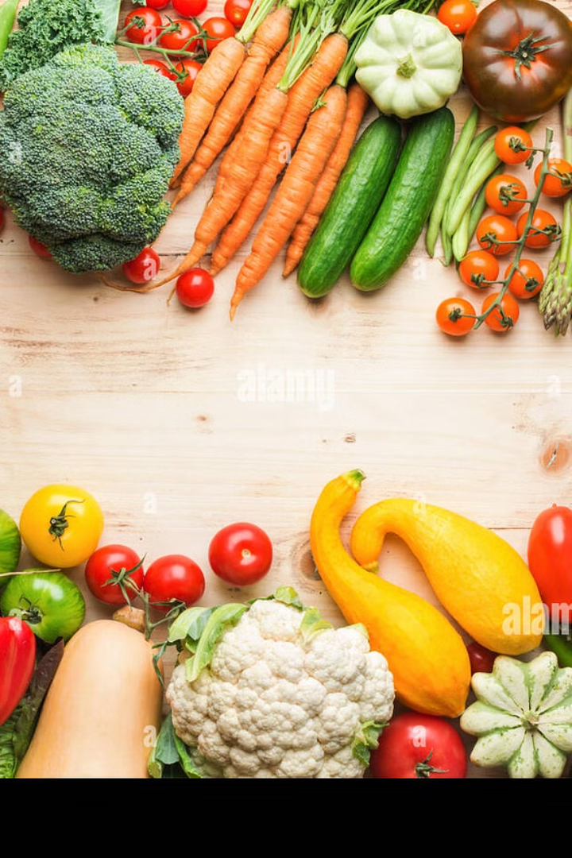
Sustainability & Certifications: Our Commitment to the Planet
Certifications
Holding certifications like USDA Organic and Fair Trade to ensure the highest quality and ethical sourcing of our products.
Eco-Friendly Packaging
Utilizing biodegradable and recyclable packaging to minimize environmental impact and promote responsible consumption.
Carbon-Neutral Delivery
Offsetting carbon emissions associated with delivery through partnerships with organizations that support renewable energy.
Community Partnerships
Supporting local farms and initiatives that promote sustainable agriculture and healthy food access.

Slide 16

Customer Support: Fostering Trust & Loyalty
Live Chat
Email Support
Phone Support
FAQ & Order Tracking
Real-time assistance for immediate questions and concerns, providing prompt and personalized support.
For detailed inquiries and feedback, ensuring comprehensive responses and timely resolutions.
Direct communication for urgent matters, offering personalized assistance and dedicated service.
A comprehensive FAQ section for common questions and a user-friendly order tracking system for transparency and peace of mind.

Slide 17
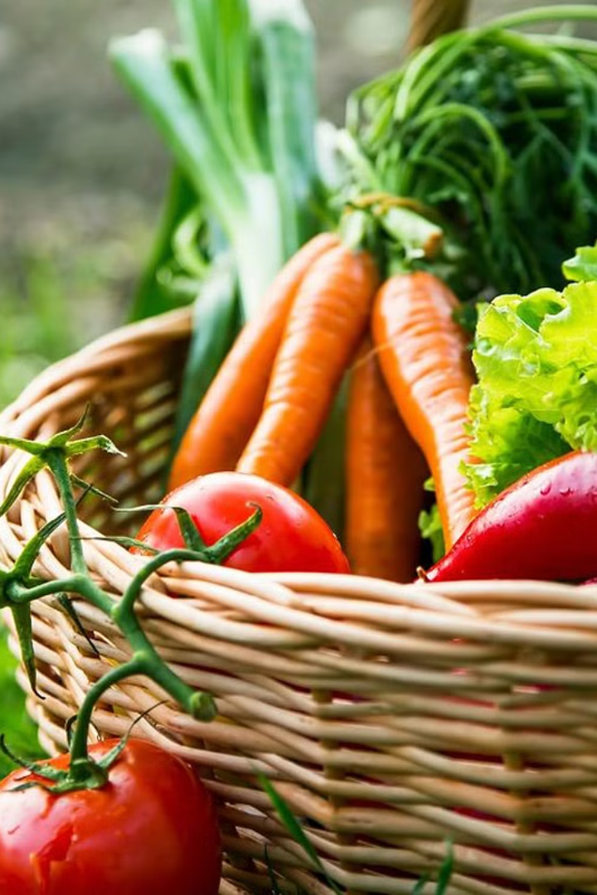




Marketing Strategy: Reaching Foodie Fans
Social Media Campaigns
Influencer Collaborations
Email Newsletters
Engaging content, targeted ads, and influencer partnerships across major platforms to drive brand awareness and customer engagement.
Personalized content, exclusive promotions, and recipe inspiration delivered directly to subscribers, nurturing customer relationships.
Partnering with food bloggers, chefs, and health enthusiasts to reach a wider audience and promote Foodie's values and products.
Targeted Promotions
Offering discounts, bundles, and seasonal specials to attract new customers and incentivize repeat purchases.

Slide 18





Future Roadmap: Embracing Innovation & Growth
Mobile Application
Smart Home Integration
Market Expansion
AI-Powered Recommendations
Seamless & personalized shopping experience.
Convenient grocery ordering & meal planning.
Bringing high-quality organic food to a wider audience.
Personalized product suggestions & tailored experiences.

Slide 19
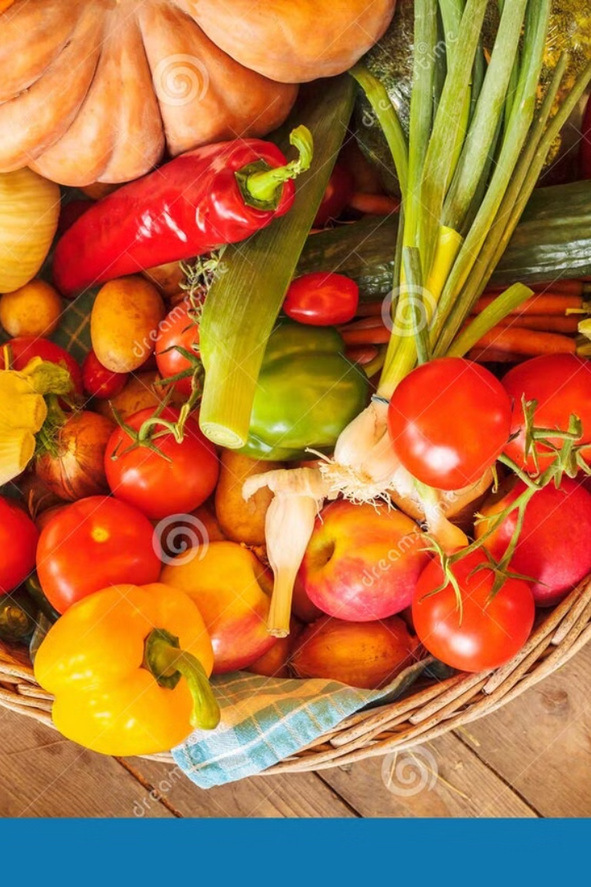
Join the Foodie Community:
Be a Part of Something Good
At Foodie, we are more than just an online marketplace.
We are a community of individuals committed to healthy eating, sustainable living, and supporting local farmers.
Join us on this journey, and let's make a difference together.
Start Your Foodie Journey Today
Ready to experience the difference of fresh, organic produce delivered straight to your door? Visit our website to browse our selection, create an account, and begin your Foodie journey today. Let's nourish ourselves and support a sustainable future together.

Slide 20

Thank You

